Slide 1
Chemistry 3A
Introductory General Chemistry
Mixtures: Heterogeneous & Homogeneous; Solutions & Aqueous Solutions; Solubility of Solids and Gases; Concentration: Percent of Dissolution, Molarity, Calculations; Colligative Properties; Molality; Osmosis
S. M. Halloran

Slide 2
Mixtures: Heterogeneous & Homogeneous
Solutions & Aqueous Solutions
Solubility of Solids and Gases
Concentration: Percent of Dissolution, Molarity, Calculations
Colligative Properties, Molality, Freezing Point Depression, Boiling Point Elevation, Osmosis

Slide 3
Solutions
Solutions are homogeneous mixtures which are usually visibly liquid but can also be gaseous
  Mixture: A combination of two or more substances that are physically mixed (not chemically bonded). Each substance retains its own chemical identity and can often be separated by physical means
  Trail mix, sand and water are heterogeneous;
  saltwater and air are homogeneous
  Homogeneous: Such mixtures are look like a single substance but are composed of two or more substances that are indistinguishable by eye
  Saltwater, air, brass (a metal alloy).

Slide 4
Solutions
The solvent is the major component of the solution
The solute is the minor component of the solution
  “Major” here means its mass or particle count (moles) is far larger than the mass or particle count (moles) of what is “minor”
Salt water has the minor component sodium chloride (NaCl) dissolved in the major component H₂O as its liquid (water)
Even air (the atmosphere) is considered a solution in which the solute diatomic oxygen (O₂) is dissolved in a solvent of diatomic nitrogen (N₂)
Air is 78% N₂ and 21% O₂

Slide 5
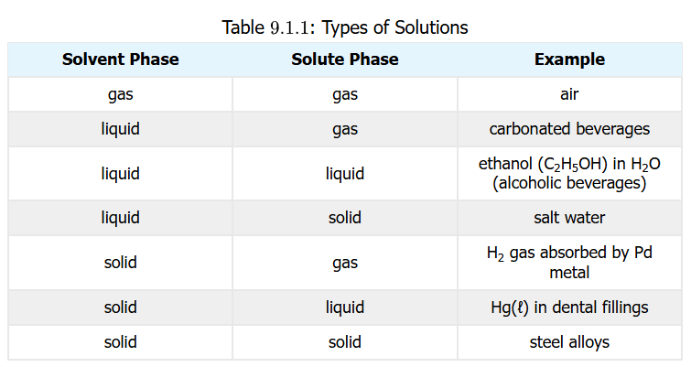
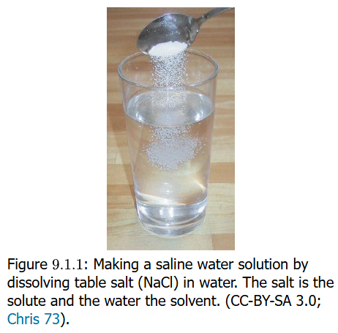
Solutions: Quiz Time
1.00 g sucrose (C₁₂H₂₂O₁₁) is dissolved in 100.0 g of H₂O liquid (water). What is the solvent and what is the solute?
  The sucrose is clearly a minor component by mass compared to water. Sucrose is the solute, water the solvent
3.33 g HCl gas is dissolved in 40.0 g of CH₃OH (methanol, methyl alcohol). Identify solvent and solute
  HCl (g) solute, CH₃OH (l) solvent

Slide 6
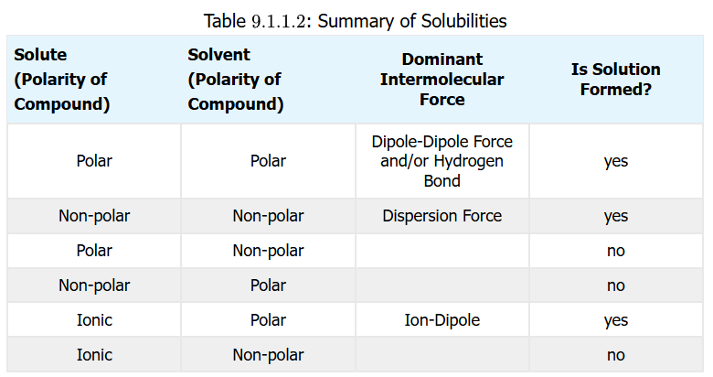
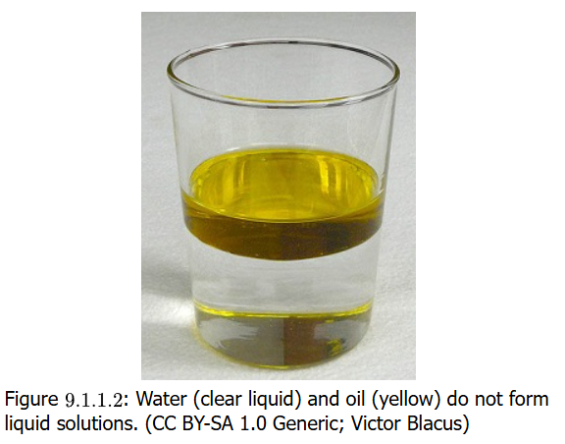
Will It Dissolve?
“Like dissolves like” generally
This means polar solutes in polar solvents. But ionic solutes also dissolve in polar solvents
Nonpolar solutes dissolve in nonpolar solvents
EXCEPTIONS: a very small amount (fraction) of nonpolar solutes mix polar solvents (O₂ and CO₂ dissolving in H₂O), and same for polar solutes in nonpolar solvents (water in oil)

Slide 7
Practice: Will It Dissolve?
Would I₂ (diatomic molecule iodine) be more soluble in CCl₄ (carbon tetrachloride) or H₂O (water)?
  I₂ is nonpolar. CCl₄ is nonpolar and H₂O is polar, so expect I₂ to be much more soluble in CCl₄ than H₂O
Would C₃H₇OH (any of isomers of propanol) be more soluble in CCl₄ (carbon tetrachloride) or H₂O (water)?
  C₃H₇OH is polar particularly because it is capable of hydrogen bonding, and H₂O also does hydrogen bonding. Expect C₃H₇OH to be much more soluble in H₂O than CCl₄

Slide 8
Practice: Will It Dissolve?
Which of these will be solutes in the solvent water?
Methanol (CH₃OH)
  Both water and methanol have hydroxyl (–OH) functional groups that make these molecules polar. So they will mix
    Note methanol (methyl alcohol) is a solvent in its own right: so two solvents that are mixed to form solution are said to be miscible
Sodium sulfate (Na₂SO₄)
  Na₂SO₄ is an ionic compound. Ionic compounds have atoms (or polyatomic molecules as ions) that have permanent electric charge character, either positive (cationic) or negative (anionic) charge. These always prefer a polar than a nonpolar solvent, so will dissolve in water
Octane (C₈H₁₈)
C₈H₁₈ is a nonpolar compound. Compounds of just carbon and hydrogen will generally be nonpolar. So it will not dissolve

Slide 9
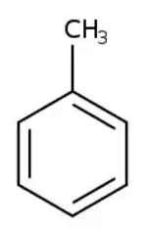
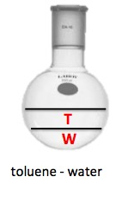
Practice: Will It Dissolve?
Which of these will be substances will
dissolve in nonpolar solvent toluene (C₆H₅CH₃)
H₂O (water)
  Water is quite polar. And following the rule of “like
  dissolves like” which means “polar dissolves polar”
  and “nonpolar dissolves nonpolar”, these will not
  mix (see image)
Na₂SO₄ (sodium sulfate)
  It was noted that Na₂SO₄ is an ionic compound.
  Ionic compounds will interact with polar solvents ONLY
C₈H₁₈ (octane)
As a nonpolar compound, C₈H₁₈ will have no problem dissolving in a nonpolar solvent like toluene

Slide 10
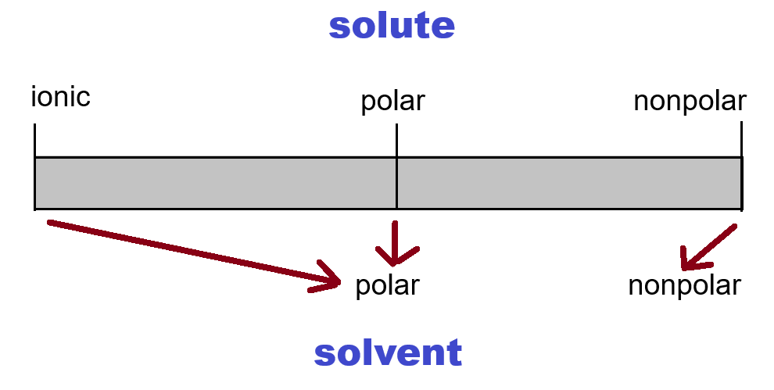
“Like Prefers to Dissolve in Like”
What about ionic solvents?
Yes there are ionic solvents
Molten salts (melted NaCl, KNO3, etc)
Room temperature ionic liquids (RTILs)

Slide 11
Electrolytes
Ionic compounds dissolving in a solvent create a solution with electrolytes
Substances dissolving but not being ions (ionic) in solution are nonelectrolytes
If the ionic solute dissolves (almost) entirely in the solvent, it is a strong electrolyte and a good conductor
If ionic solute dissolves only partially, it is likely a weak electrolyte and likely not a good conductor

Slide 12
Nonelectrolytes
Nonelectrolytes
  Anything that does not produce an ion
  These are generally the molecular class of compounds with the exception of the polyatomic ions, which by their nature are bonded nonmetal atom groups that form ions typically to form a stable octet around the atoms.
  NO₂, CO₂, NH₃, SO₂, SO₃ are (polyatomic) molecules that can dissolve in water, even though gases, and are nonelectrolytes.
  NO₃–, CO₃^{2–}, NH₄⁺, SO₃²⁻, SO₄²⁻ are polyatomic ions forming compounds with oppositely charged ionic forms of other elements forming electrolytes

Slide 13






forms ions; is electrolyte
does not form ions, is nonelectrolyte
does not form ions, is nonelectrolyte
does not form ions, is nonelectrolyte
does not form ions, is nonelectrolyte
forms ions; is electrolyte
forms ions; is electrolyte
Ionic compounds dissolve into a polar solvent like H₂O to form ions in solution, making them electrolytes. Those not forming ions in solution are nonelectrolytes

Slide 14
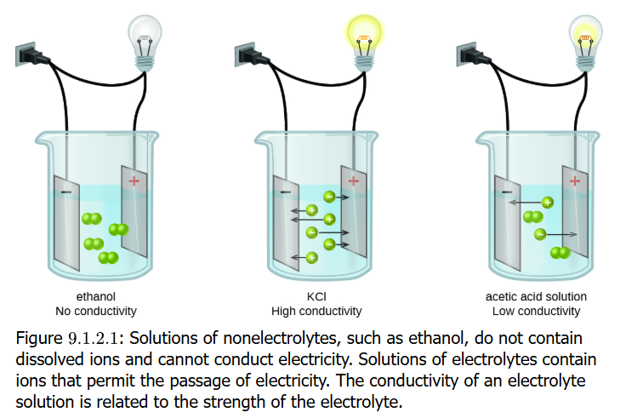
Carrying Electric Current
Aqueous solutions with dissolved electrolytes conduct electricity
The dissolved ions move freely in the solvent when an external voltage is applied
Dissolved ions of the
one charge move to
the electrode of
opposite charge,
creating the
continuity that is
the electric current
If solute does not
produce ions, there is
no electric current

Slide 15
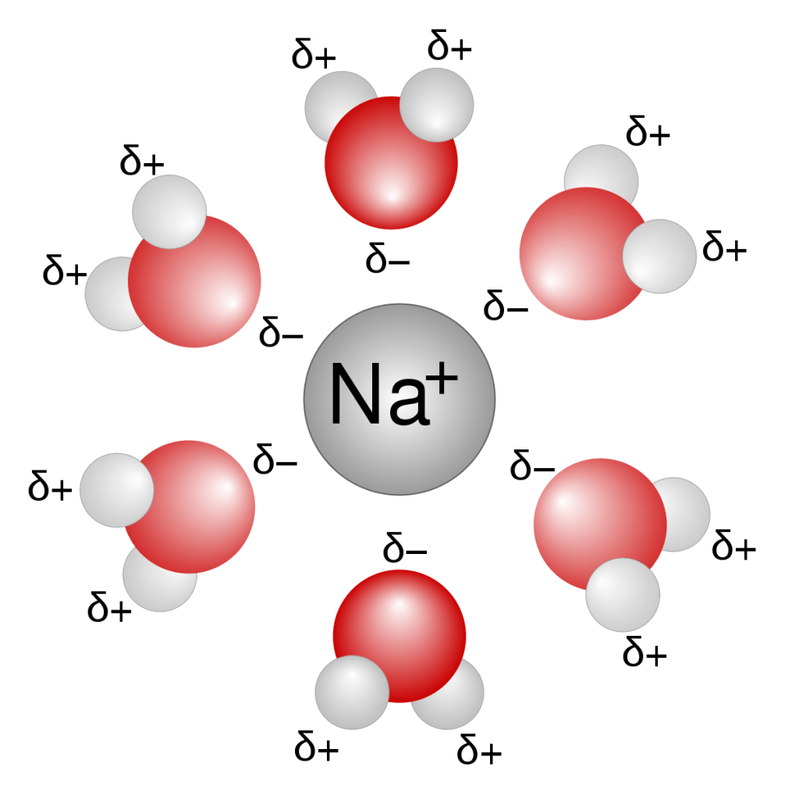
Ion-Dipole Attraction
Ionic compounds (salts) dissolve as ions in polar solvents like water
Water has no electric charge like a dissolved ion
But it DOES have a dipole (recall from previous unit)
That dipole in the H₂O molecule formed by the electron group & molecular geometry of
the molecule enables
interactions with dissolved ions
For NaCl (sodium chloride),
note how the oxygen (O) atom
with its negative dipole orients
itself to Na⁺ (sodium) ions
And the hydrogen (H) atoms
with their positive dipole will
orient themselves to the Cl–
(chlorine/ “chloride”) ions

Slide 16
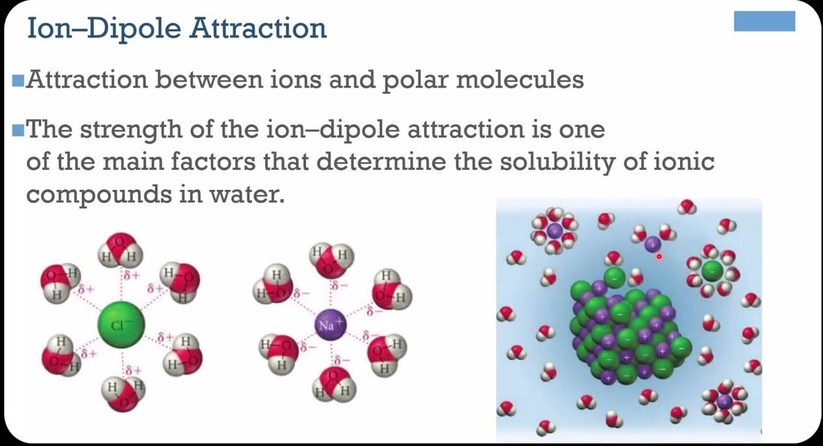
Ion-Dipole Attraction
The ion-dipole attraction actually helps to dissolve the salt crystal/solid
During the dissolution process, ions leave the solid (crystal) and are solvated in a physical process called dissociation, forming the electrolytic solution

Slide 17
Which Become Ions in Solution?
It needs to be an ion (an ionic compound)
Except for polyatomic molecules forming ions, molecules whether polar or nonpolar will not form ions!
LiF - lithium fluoride
  yes
P₂F₅ - diphosphorus pentafluoride
  no: all bonded are covalent and don’t break apart in a solvent
C₂H₅OH (or CH₃CH₂OH) - ethanol
  no, a covalent molecule
C₆H₁₂O₆ - glucose
  no, a covalent molecule
CCl₄ - carbon tetrachloride
  no a covalent molecule and also nonpolar
CaCl₂ - calcium chloride
  yes
AgNO₃ (silver nitrate)
  yes

Slide 18
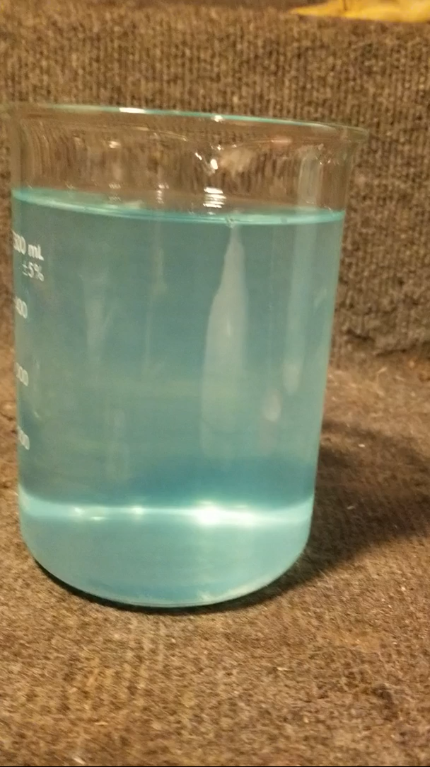
Solubility in Aqueous Solutions
Some ions (a cation and an anion) that are brought together in solution will form a complex quickly and precipitate out of solution, forming a solid in the solution
A classic example is silver (Ag⁺)
cation binding or combining (not
bonding) with chloride (Cl–) anion
to form the silver chloride (AgCl)
precipitate
Several ion combinations occurring
in solution and having no or low
solubility—thus forming precipitates—
are known (table next page)
Video shows HCl being added to AgNO₃ (aq) to form AgCl (s)

Slide 19
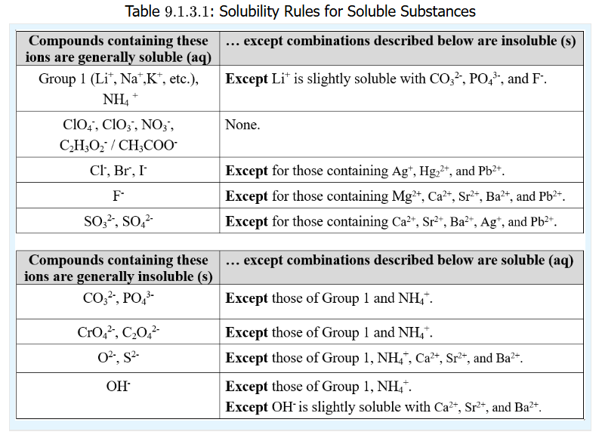
Solubility in Aqueous Solutions
These rules for solubility concerning the various ion combinations in aqueous solutions are part of the Green Sheet
If you are asked
about whether
the mixing of
solutions with
soluble ions form
a precipitate,
be prepared to
say yes or no
by understanding
the table

Slide 20
Practice: Is It Soluble?
Refer to the Green Sheet
Zn(NO₃)₂ (zinc nitrate)
  The solubility table indicates ALL nitrates are soluble
PbBr₂ (lead(II) bromide)
  Table states all bromides are soluble except when combined with Pb²⁺ lead ion
Sr₃(PO₄)₂ (strontium phosphate)
  Table states all phosphates are insoluble (not soluble), so Sr₃(PO₄)₂ is
Mg(OH)₂ (magnesium hydroxide)
  The Group 2 ion is insoluble with hydroxide ion
KBr (potassium bromide)
  Soluble: Group 1 ions like K⁺ are soluble except for Li⁺ in some combination
Pb(NO₃)₂ (lead(II) nitrate)
  Table states all nitrates are soluble with no exceptions

Slide 21
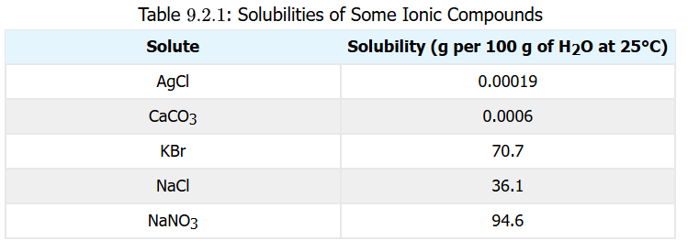
Solubility and Saturation
Some salt (cation-anion) combinations like silver chloride (AgCl) are not really soluble at all (see table below)
But many salts, while quite soluble, have a maximum limit of dissolution such that addition of more salt will NOT dissolve the added salt
The solute has reached a maximum saturation
Sodium chloride (NaCl) added above 36.1 g to 100 g H₂O will not dissolve the added NaCl.
The solution is
said to be
“saturated” with
NaCl solute

Slide 22
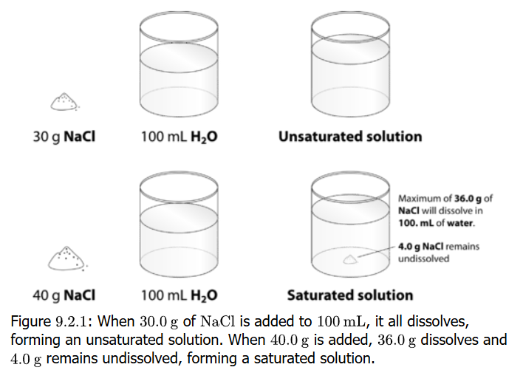
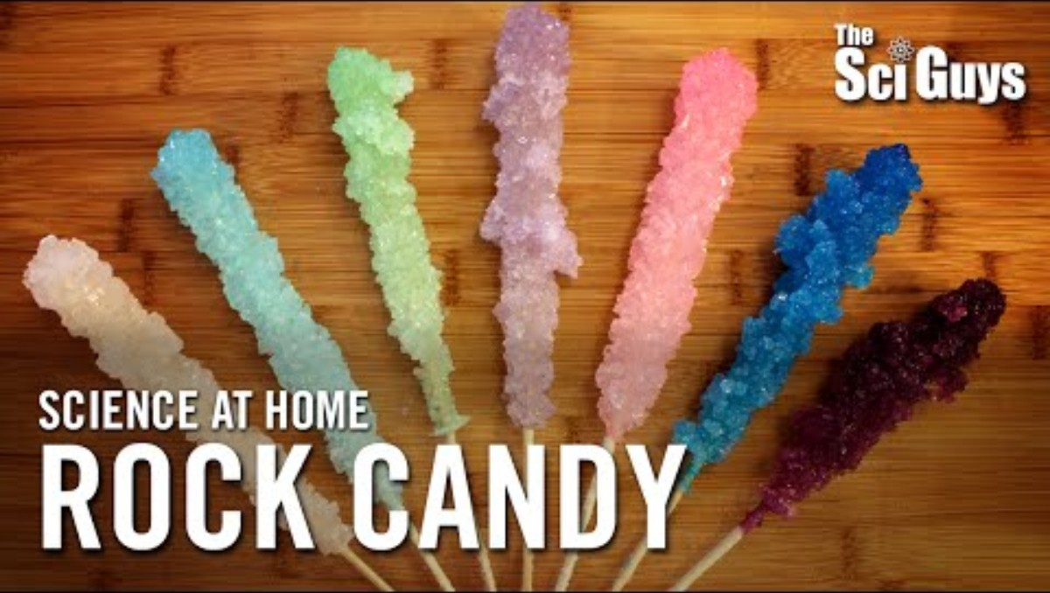
Saturated / Unsaturated
Saturation represents the
upper limit of how much a
substance will dissolve in
a given amount of solvent
Beyond that upper limit,
no more substance will
dissolve within the solvent
(the solution)
Sometimes solutions are purposely
saturated and excess undissolved
substance will be filtered out. This is
called a saturated solution
When a solute has not reached its
maximum saturation, it is called
unsaturated

Slide 23
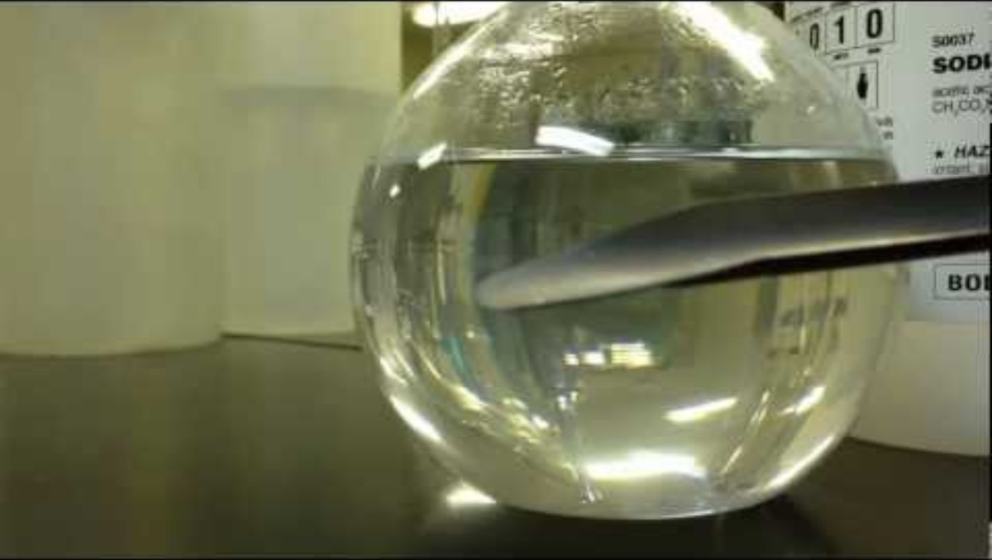
Supersaturation
Want to see something cool?
Add 175 g sodium acetate trihydrate (NaOOCCH₃ • 3 H₂O) to a 50 mL distilled water in a 500 mL Erlenmeyer flask
Heat flask inside a 2 L beaker containing 1.5 L water on hot plate until it dissolves
Invert 100 mL beaker over mouth of flask and allow to cool (a couple of hours)
Add a seed crystal or “scratch” the flask glass inside and watch the fun

Slide 24
Supersaturation
Maximum solubility (limits of saturation) are temperature-dependent
Solubility usually increases as the temperature goes up
Suppose you heat a solution and add solute up to its maximum solubility while make sure all solute dissolves
Now you cool the solution and solute mass is far above its maximum solubility for the temperature
Yet solute remains dissolved (not precipitating out)
This is supersaturation

Slide 25
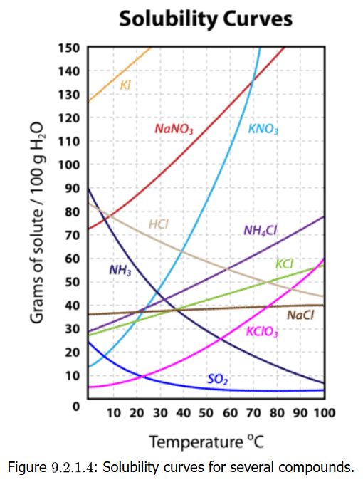
Solids Dissolved in Water
The solubility of a substance
is the mass representing the
upper limit of a solute dissolving
in a solvent before the substance
becomes saturating
It is usually measured as
g of solute per 100 g solvent
Up to 36.0 g NaCl can be
added to 100 g H₂O at 20°C
Solubility is temperature-
dependent
Up to 32 g KCl will dissolve in
100 g H₂O at 20°C,
but 55 g KCl will dissolve in 100 g H₂O at 100°C

Slide 26
Solids Solubility vs Temp
Note the trends in the solubility curves
NaCl is flat
KNO₃ goes steeply up with temp
Why?
Dissolving NaCl is both
endothermic and exothermic:
  The endothermic part breaks the
  crystal lattice & this requires energy
  The exothermic part is the hydration of
  Na⁺ and Cl–, and this release energy
Dissolving KNO₃ requires a LOT of
energy and is HIGHLY endothermic
and the hydration of K⁺ and NO₃⁻
does not release enough energy
Increasing temperature would add
energy to processes that are highly endothermic like dissolving solids needing the energy

Slide 27
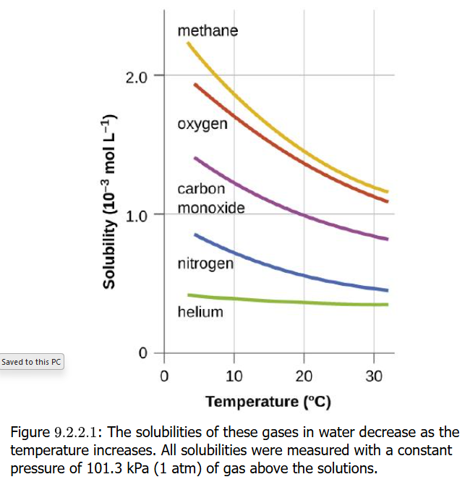
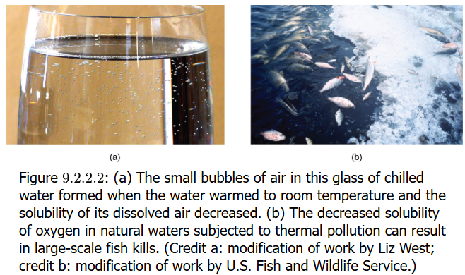
Gas Solubility vs Temp
Look at the solubility of HCl,
NH₃ and SO₂
  Solubility of these goes down
  with increasing temperature
He < O₂ << CHCl₃ in H₂O
  in this case, intermolecular forces
  such as molecular polarity and
  potential hydrogen bonding affect
  solubility
If water temperature
goes up, O₂ solubility
is severely affected
and could deny
water life the gas it
needs to survive
(fish kills)

Slide 28
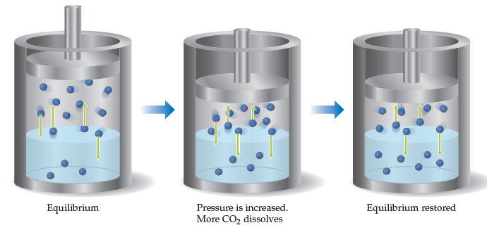
Gas Solubility vs Pressure
  This is offered because it is a homework question
  More will be discussed in Lecture Set 13 on Equilibrium
  If you increase* the partial pressure above an aqueous solution, then the solubility of the specific gas for the aqueous solution will increase.
  * This increase would be reducing volume without changing gas composition

Slide 29
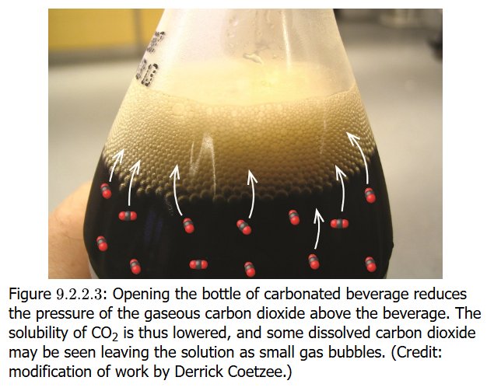
Partial Pressure of Gas Solute
Gas solutes are affected by partial
pressure of the solute in the gas
to which a solution is exposed
If total gas pressure is increased,
the solubility of gas in a solution
increases
Atmospheric pressure decreases with altitude/elevation, so the solubility of gases in lake water at higher altitude will be less than at lower altitudes/elevations. (see Henry’s Law)
Carbonated beverages
  Beverages are capped/contained within high pressures of CO₂ gas
  When the cap is released, CO₂ rapidly leaves solution to enter atmosphere: fizzing, small bubbles
  This is a supersaturation effect of CO₂

Slide 30
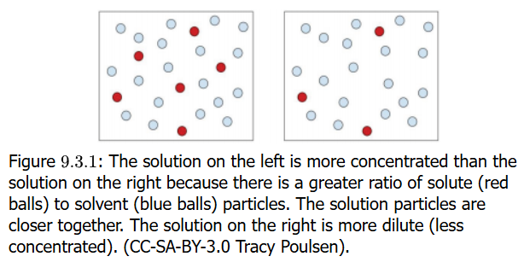
Concentration
A solution is composed of
a solute and a solvent,
and the amount of solute
dissolved in the solvent is
called a concentration
A 5% acetic acid (vinegar) in water is a concentration
A 10% acetic acid is more concentrated than a 5% solution. The 5% solution is more dilute

Slide 31
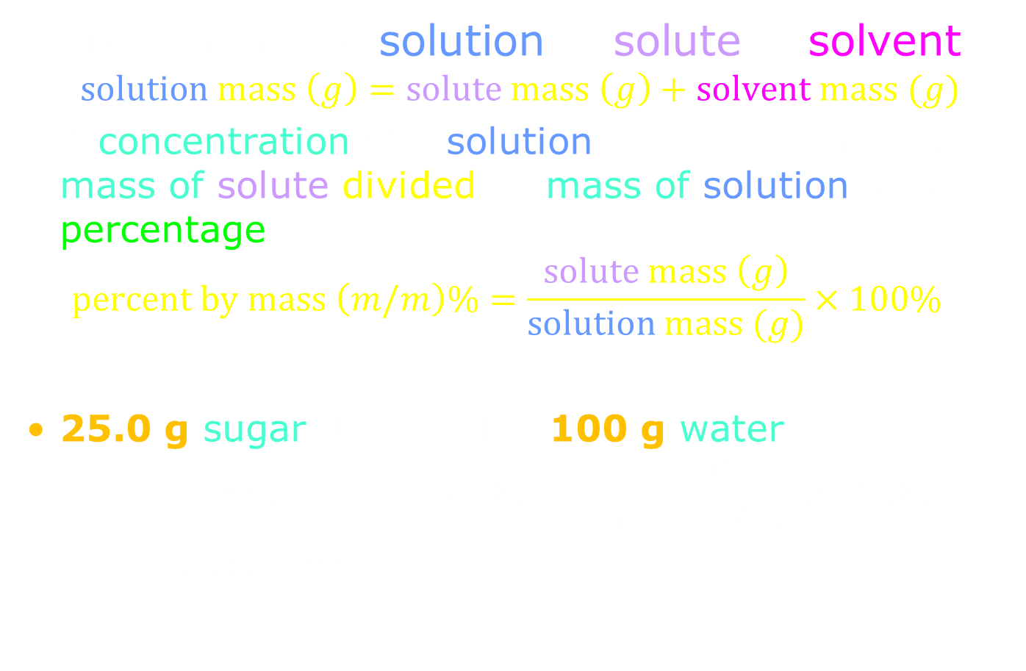
Percent Solutions
Preliminary: a solution = solute + solvent
$$solution mass \left(g\right)=solute mass \left(g\right)+solvent mass (g)$$
A concentration of a solution can be indicated by a mass of solute divided by mass of solution as a percentage
  $$percent by mass \left(m/m\right)\%=\frac{solute mass \left(g\right)}{solution mass (g)}×100\%$$
25.0 g sugar dissolved in 100 g water is:
$$percent by mass \left(m/m\right)\%=\frac{25.0 g}{\left(25.0+100\right)g}×100\%=20.0\% sugar$$

Slide 32
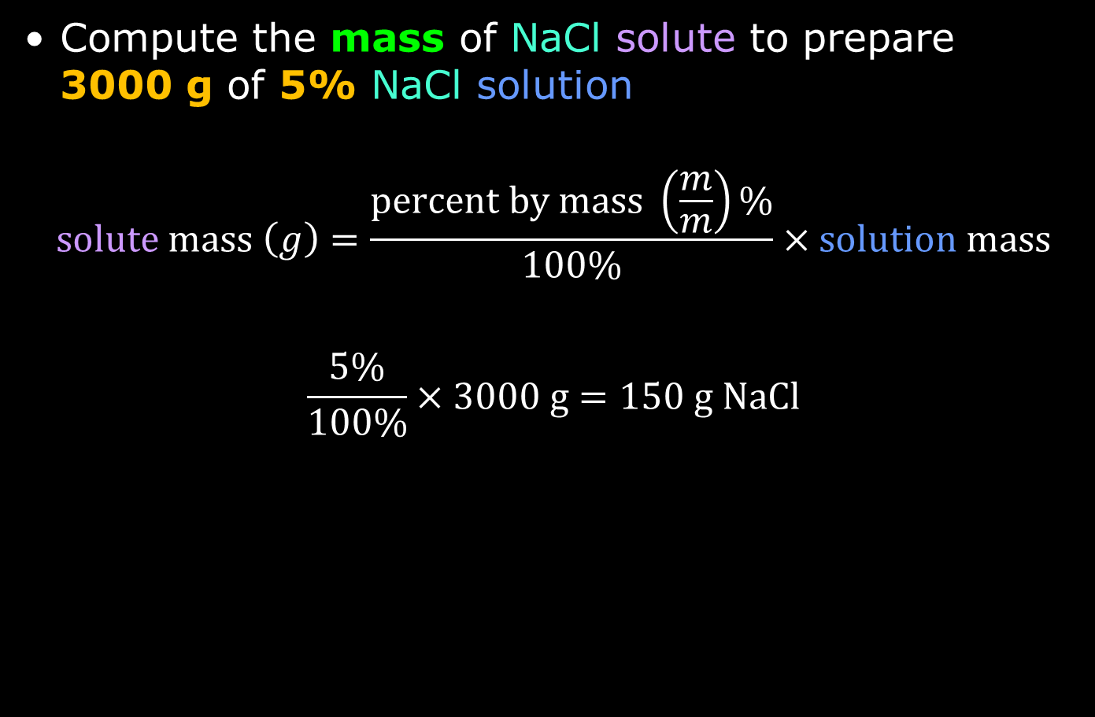
Mass Percent Solutions
Compute the mass of NaCl solute to prepare
3000 g of 5% NaCl solution
$$solute mass \left(g\right)=\frac{percent by mass \left(\frac{m}{m}\right)\%}{100\%}×solution mass$$
$$\frac{5\%}{100\%}×3000 g=150 g NaCl$$

Slide 33
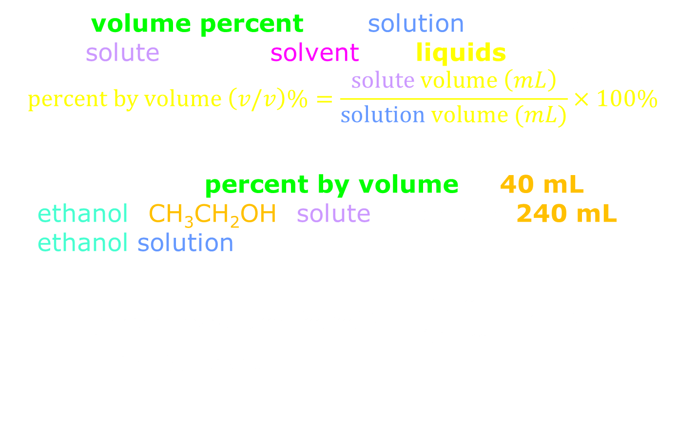
Volume Percent Solutions
The volume percent of a solution is used when the solute and the solvent are liquids
$$percent by volume \left(v/v\right)\%=\frac{solute volume \left(mL\right)}{solution volume (mL)}×100\%$$
Compute the percent by volume of 40 mL ethanol (CH₃CH₂OH) solute to prepare 240 mL ethanol solution
$$percent by volume \left(m/m\right)\%=\frac{40 mL}{240 mL}×100\%=16.7\% ethanol$$

Slide 34
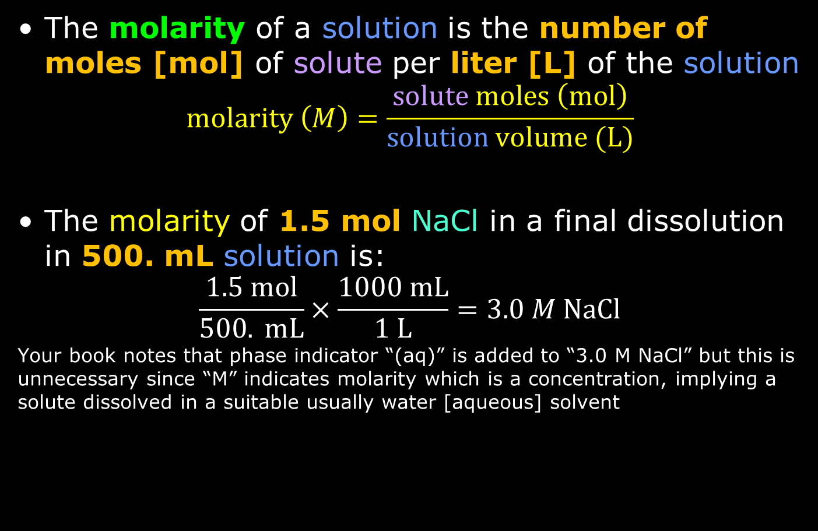
Molarity of Solutions
The molarity of a solution is the number of moles [mol] of solute per liter [L] of the solution
$$molarity \left(M\right)=\frac{solute moles \left(mol\right)}{solution volume (L)}$$
The molarity of 1.5 mol NaCl in a final dissolution in 500. mL solution is:
$$\frac{1.5 mol}{500. mL}×\frac{1000 mL}{1 L}=3.0 M NaCl$$
Your book notes that phase indicator “(aq)” is added to “3.0 M NaCl” but this is unnecessary since “M” indicates molarity which is a concentration, implying a solute dissolved in a suitable usually water [aqueous] solvent

Slide 35
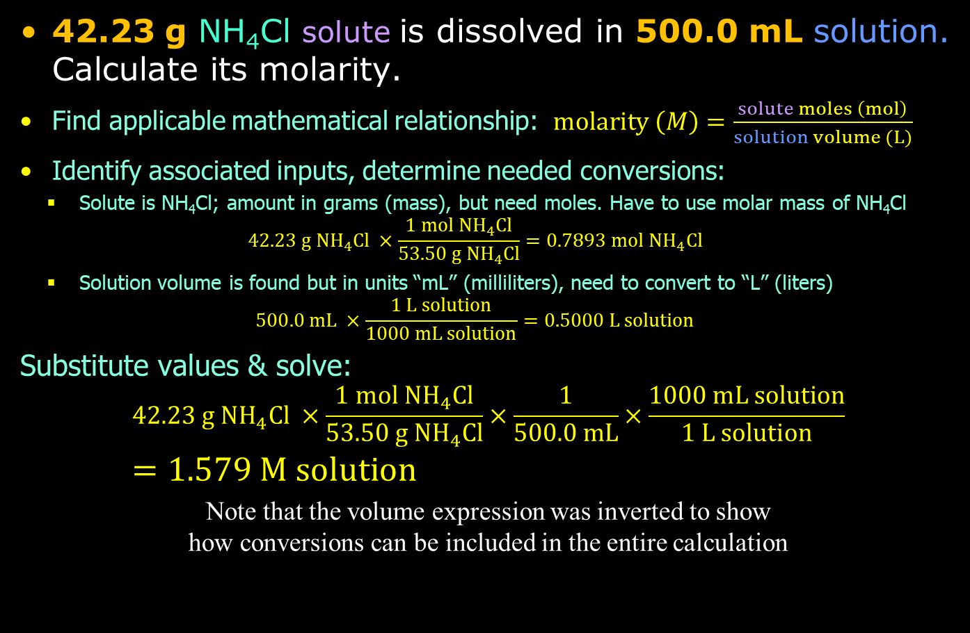
Practice: Molarity
42.23 g NH₄Cl solute is dissolved in 500.0 mL solution. Calculate its molarity.
Find applicable mathematical relationship: $molarity \left(M\right)=\frac{solute moles \left(mol\right)}{solution volume (L)}$
Identify associated inputs, determine needed conversions:
  Solute is NH₄Cl; amount in grams (mass), but need moles. Have to use molar mass of NH₄Cl
  $$42.23 g NH_{4}Cl ×\frac{1 mol NH_{4}Cl}{53.50 g NH_{4}Cl}=0.7893 mol NH_{4}Cl$$
  Solution volume is found but in units “mL” (milliliters), need to convert to “L” (liters)
  $$500.0 mL ×\frac{1 L solution}{1000 mL solution}=0.5000 L solution$$
Substitute values & solve:
$$42.23 g NH_{4}Cl ×\frac{1 mol NH_{4}Cl}{53.50 g NH_{4}Cl}×\frac{1}{500.0 mL}×\frac{1000 mL solution}{1 L solution} \\ =1.579 M solution$$
Note that the volume expression was inverted to show
how conversions can be included in the entire calculation

Slide 36
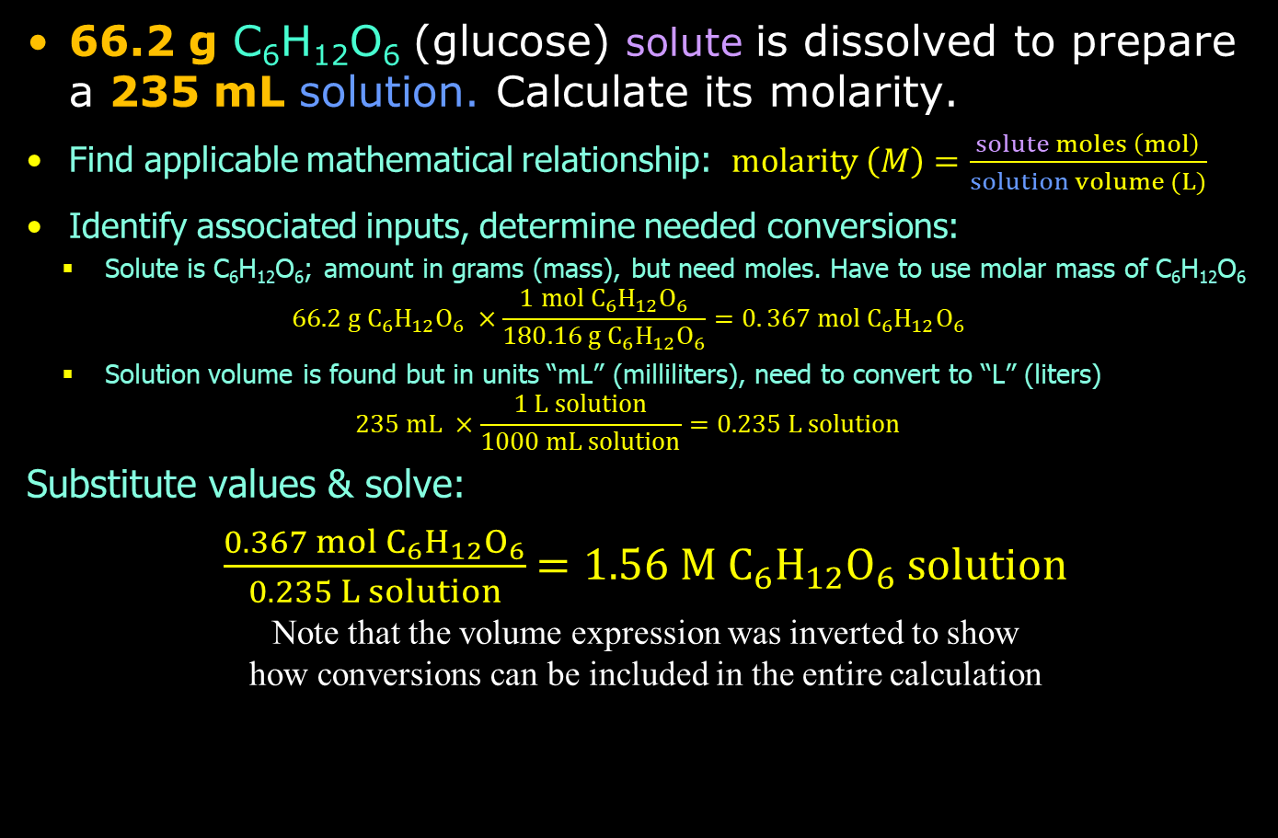
Practice: Molarity
66.2 g C₆H₁₂O₆ (glucose) solute is dissolved to prepare a 235 mL solution. Calculate its molarity.
Find applicable mathematical relationship: $molarity \left(M\right)=\frac{solute moles \left(mol\right)}{solution volume (L)}$
Identify associated inputs, determine needed conversions:
  Solute is C₆H₁₂O₆; amount in grams (mass), but need moles. Have to use molar mass of C₆H₁₂O₆
  $$66.2 g C_{6}H_{12}O_{6} ×\frac{1 mol{ C}_{6}H_{12}O_{6}}{180.16 g{ C}_{6}H_{12}O_{6}}=0. 367 mol{ C}_{6}H_{12}O_{6}$$
  Solution volume is found but in units “mL” (milliliters), need to convert to “L” (liters)
  $$235 mL ×\frac{1 L solution}{1000 mL solution}=0.235 L solution$$
Substitute values & solve:
$\frac{0.367 mol{ C}_{6}H_{12}O_{6}}{0.235 L solution}$ $=1.56 M{ C}_{6}H_{12}O_{6} solution$
Note that the volume expression was inverted to show
how conversions can be included in the entire calculation

Slide 37
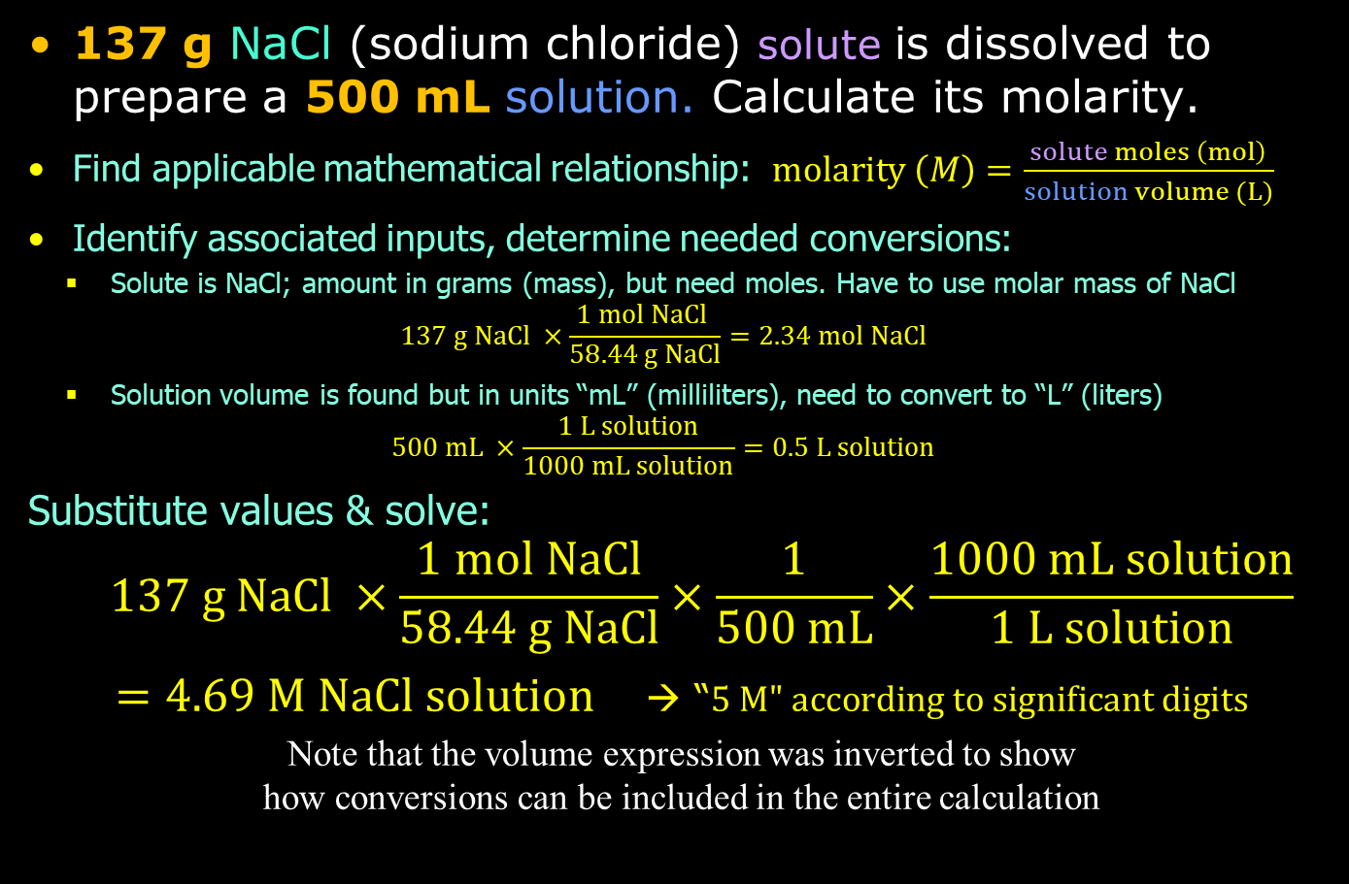
Practice: Molarity
137 g NaCl (sodium chloride) solute is dissolved to prepare a 500 mL solution. Calculate its molarity.
Find applicable mathematical relationship: $molarity \left(M\right)=\frac{solute moles \left(mol\right)}{solution volume (L)}$
Identify associated inputs, determine needed conversions:
  Solute is NaCl; amount in grams (mass), but need moles. Have to use molar mass of NaCl
  $$137 g NaCl ×\frac{1 mol NaCl }{58.44 g NaCl}=2.34 mol NaCl$$
  Solution volume is found but in units “mL” (milliliters), need to convert to “L” (liters)
  $$500 mL ×\frac{1 L solution}{1000 mL solution}=0.5 L solution$$
Substitute values & solve:
$$137 g NaCl ×\frac{1 mol NaCl}{58.44 g NaCl}×\frac{1}{500 mL}×\frac{1000 mL solution}{1 L solution}$$
$=4.69 M NaCl solution$ → “$5 M" according to significant digits$
Note that the volume expression was inverted to show
how conversions can be included in the entire calculation

Slide 38
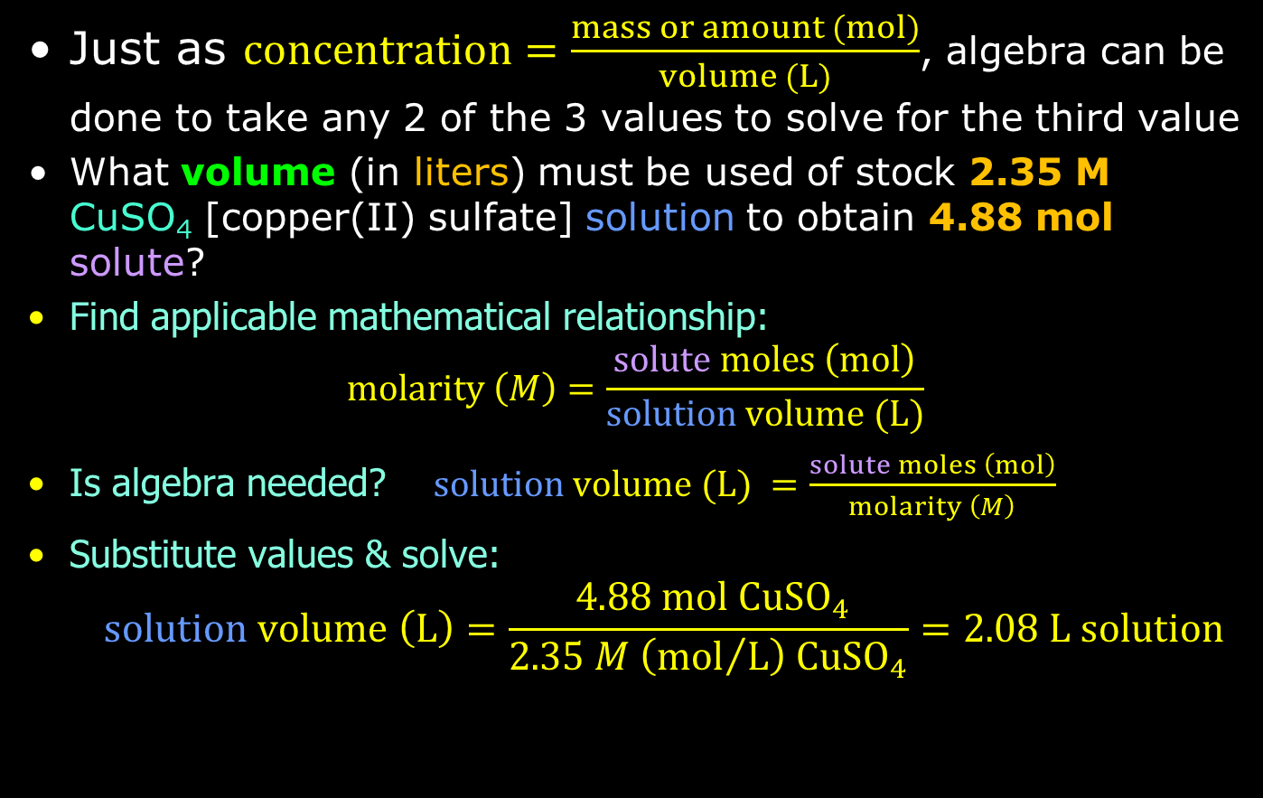
Mass = Concentration × Volume
Just as $concentration=\frac{mass or amount (mol)}{volume (L)}$, algebra can be done to take any 2 of the 3 values to solve for the third value
What volume (in liters) must be used of stock 2.35 M CuSO₄ [copper(II) sulfate] solution to obtain 4.88 mol solute?
Find applicable mathematical relationship:
$molarity \left(M\right)=\frac{solute moles \left(mol\right)}{solution volume (L)}$
Is algebra needed? $solution volume (L) =\frac{solute moles \left(mol\right)}{molarity \left(M\right)}$
Substitute values & solve:
$$solution volume \left(L\right)=\frac{ 4.88 mol CuSO_{4}}{2.35 M \left({mol}/L\right) CuSO_{4}}=2.08 L solution$$

Slide 39
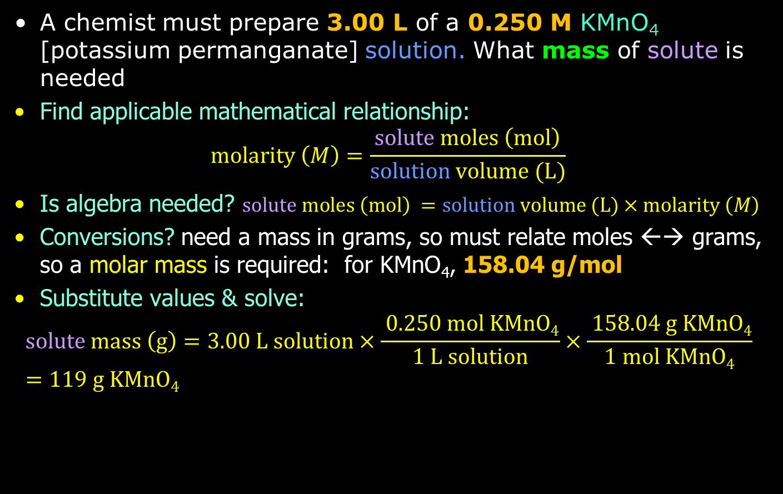
Mass = Molar Mass × Molarity × Volume
A chemist must prepare 3.00 L of a 0.250 M KMnO₄ [potassium permanganate] solution. What mass of solute is needed
Find applicable mathematical relationship:
$molarity \left(M\right)=\frac{solute moles \left(mol\right)}{solution volume (L)}$
Is algebra needed? $solute moles \left(mol\right) =solution volume (L)×molarity \left(M\right)$
Conversions? need a mass in grams, so must relate moles ←→ grams, so a molar mass is required: for KMnO₄, 158.04 g/mol
Substitute values & solve:
$$solute mass \left(g\right)=3.00 L solution×\frac{ 0.250 mol KMnO4}{1 L solution}×\frac{ 158.04 g KMnO4}{1 mol KMnO4}=119 g KMnO4$$

Slide 40
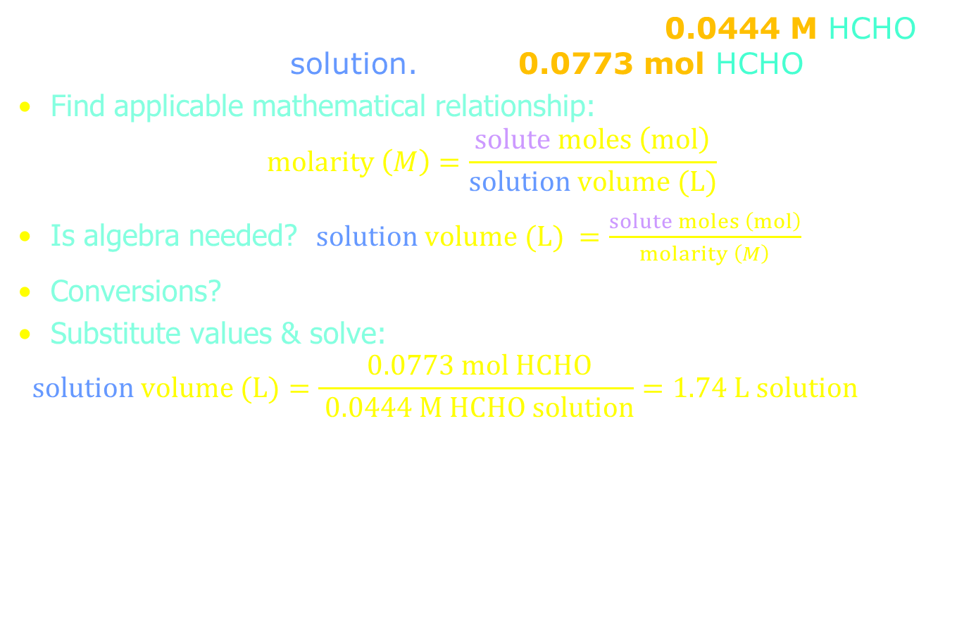
Volume = Moles (Mass) / Concentration
What is the volume (L) required to make 0.0444 M HCHO [formaldehyde] solution. Using 0.0773 mol HCHO
Find applicable mathematical relationship:
$molarity \left(M\right)=\frac{solute moles \left(mol\right)}{solution volume (L)}$
Is algebra needed? $solution volume (L) =\frac{solute moles \left(mol\right)}{molarity \left(M\right)}$
Conversions? none needed
Substitute values & solve:
$$solution volume (L)=\frac{ 0.0773 mol HCHO}{ 0.0444 M HCHO solution}=1.74 L solution$$

Slide 41
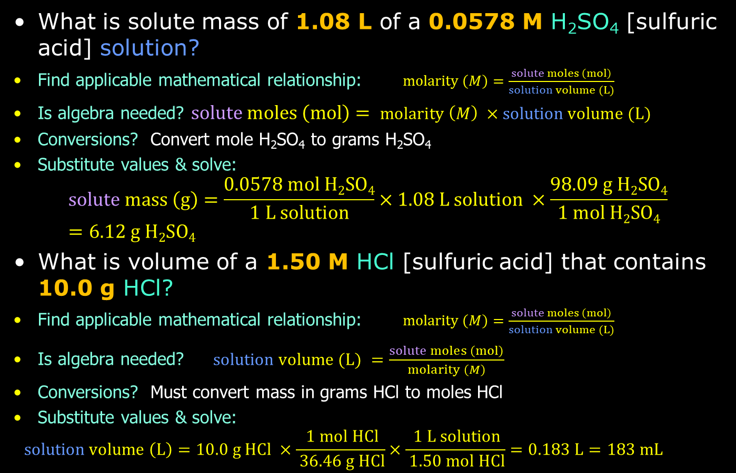
Volume = Moles (Mass) / Concentration
What is solute mass of 1.08 L of a 0.0578 M H₂SO₄ [sulfuric acid] solution?
Find applicable mathematical relationship: $molarity \left(M\right)=\frac{solute moles \left(mol\right)}{solution volume (L)}$
Is algebra needed? $solute moles \left(mol\right)= molarity \left(M\right) ×solution volume (L)$
Conversions? Convert mole H₂SO₄ to grams H₂SO₄
Substitute values & solve:
$$solute mass \left(g\right)=\frac{0.0578 mol H2SO4}{1 L solution}×1.08 L solution ×\frac{98.09 g H2SO4}{1 mol H2SO4}=6.12 g H2SO4$$
What is volume of a 1.50 M HCl [sulfuric acid] that contains 10.0 g HCl?
Find applicable mathematical relationship: $molarity \left(M\right)=\frac{solute moles \left(mol\right)}{solution volume (L)}$
Is algebra needed? $solution volume (L) =\frac{solute moles \left(mol\right)}{molarity \left(M\right)}$
Conversions? Must convert mass in grams HCl to moles HCl
Substitute values & solve:
$$solution volume \left(L\right)=10.0 g HCl ×\frac{ 1 mol HCl}{ 36.46 g HCl}×\frac{ 1 L solution}{ 1.50 mol HCl}=0.183 L=183 mL$$

Slide 42
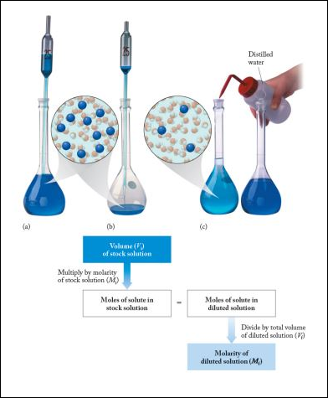
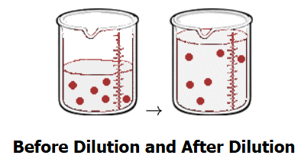
Dilutions of Solutions
Making stock solutions in
aqueous solvent by dissolving
solids in water is one thing
Another very common practice
is to make dilute solutions
from the stock solutions
The concentration (molarity) of
the dilute solution must be less
than the stock from which it is
made

Slide 43
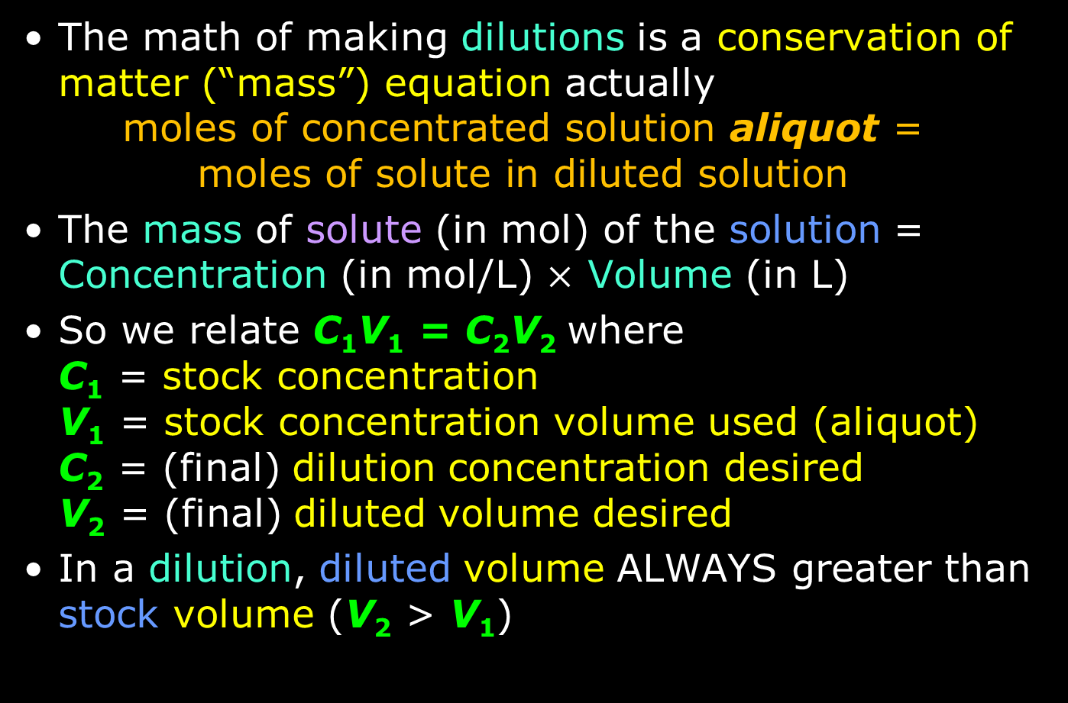
The Math of Dilutions
The math of making dilutions is a conservation of matter (“mass”) equation actually
  $$\text{m}\text{oles} \text{of} \text{concentrated} \text{solution} \text{aliquot}\text{ =}$$
  $$\text{moles} \text{of} \text{solute} \text{in} \text{diluted} \text{solution}$$
The mass of solute (in mol) of the solution = Concentration (in mol/L) $×$ Volume (in L)
So we relate C₁V₁ = C₂V₂ where
C₁ = stock concentration
V₁ = stock concentration volume used (aliquot)
C₂ = (final) dilution concentration desired
V₂ = (final) diluted volume desired
In a dilution, diluted volume ALWAYS greater than stock volume (V₂ > V₁)

Slide 44
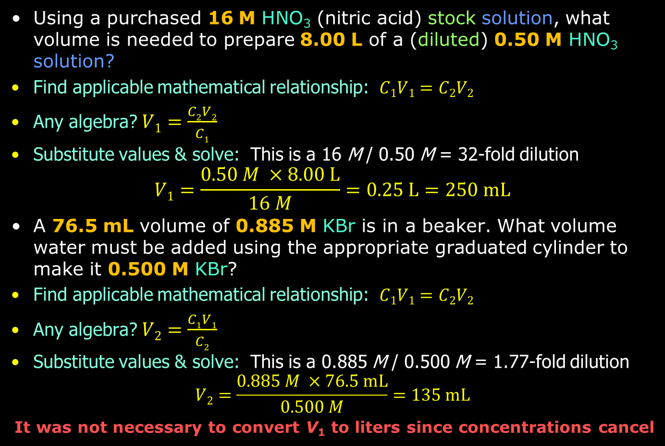
Practice: The Math of Dilutions
Using a purchased 16 M HNO₃ (nitric acid) stock solution, what volume is needed to prepare 8.00 L of a (diluted) 0.50 M HNO₃ solution?
Find applicable mathematical relationship: $C1V1=C2V2$
Any algebra? $V1=\frac{C2V2}{C1}$
Substitute values & solve: This is a 16 M / 0.50 M = 32-fold dilution
$$V1=\frac{0.50 M ×8.00 L}{16 M}=0.25 L=250 mL$$
A 76.5 mL volume of 0.885 M KBr is in a beaker. What volume water must be added using the appropriate graduated cylinder to make it 0.500 M KBr?
Find applicable mathematical relationship: $C1V1=C2V2$
Any algebra? $V2=\frac{C1V1}{C2}$
Substitute values & solve: This is a 0.885 M / 0.500 M = 1.77-fold dilution
$$V2=\frac{0.885 M ×76.5 mL}{0.500 M}=135 mL$$
It was not necessary to convert V₁ to liters since concentrations cancel

Slide 45
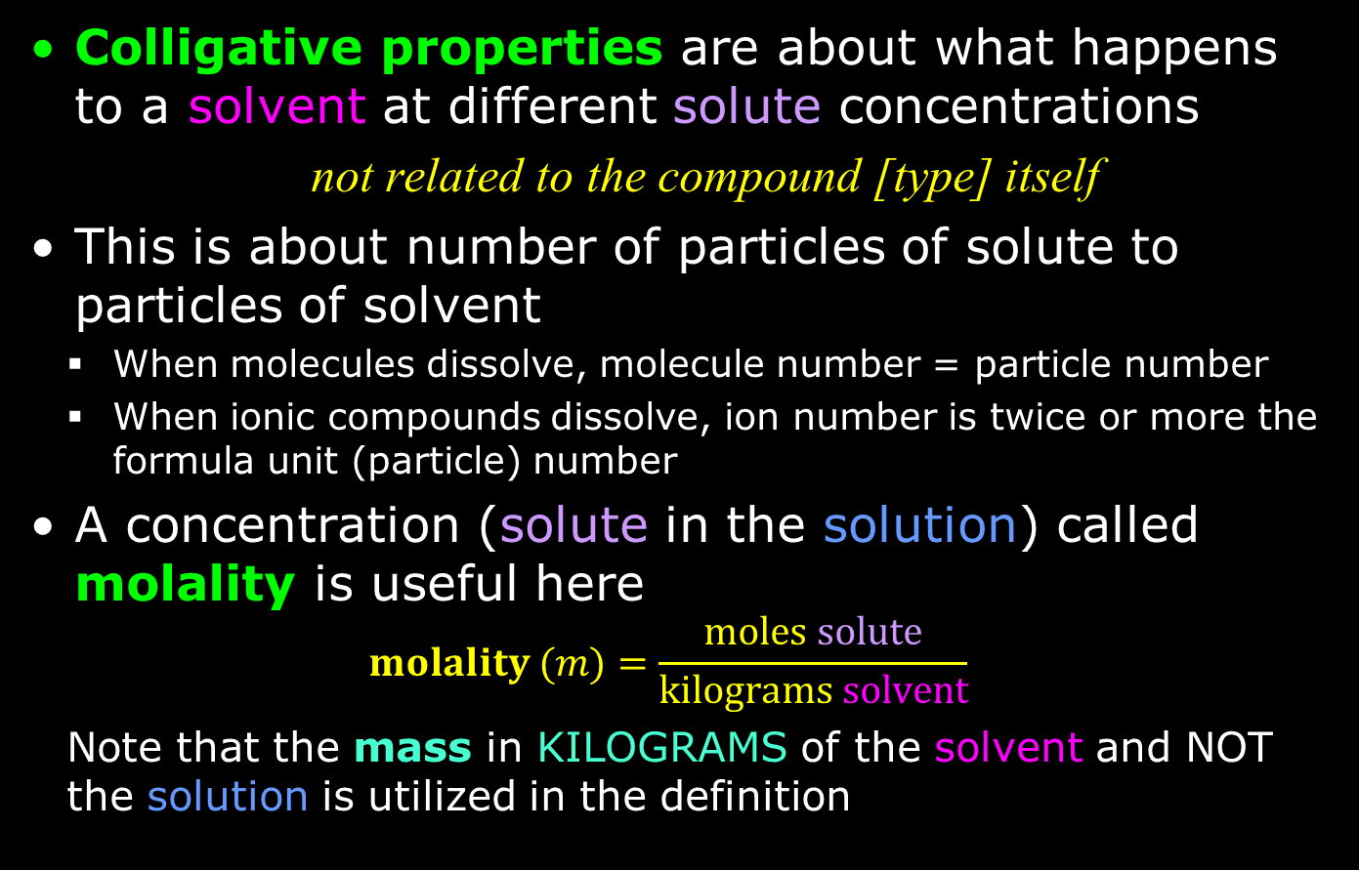
Colligative Properties: Molality
Colligative properties are about what happens to a solvent at different solute concentrations
  not related to the compound [type] itself
This is about number of particles of solute to particles of solvent
  When molecules dissolve, molecule number = particle number
  When ionic compounds dissolve, ion number is twice or more the formula unit (particle) number
A concentration (solute in the solution) called molality is useful here
  $$molality (m)=\frac{moles solute}{kilograms solvent}$$
  Note that the mass in KILOGRAMS of the solvent and NOT the solution is utilized in the definition

Slide 46
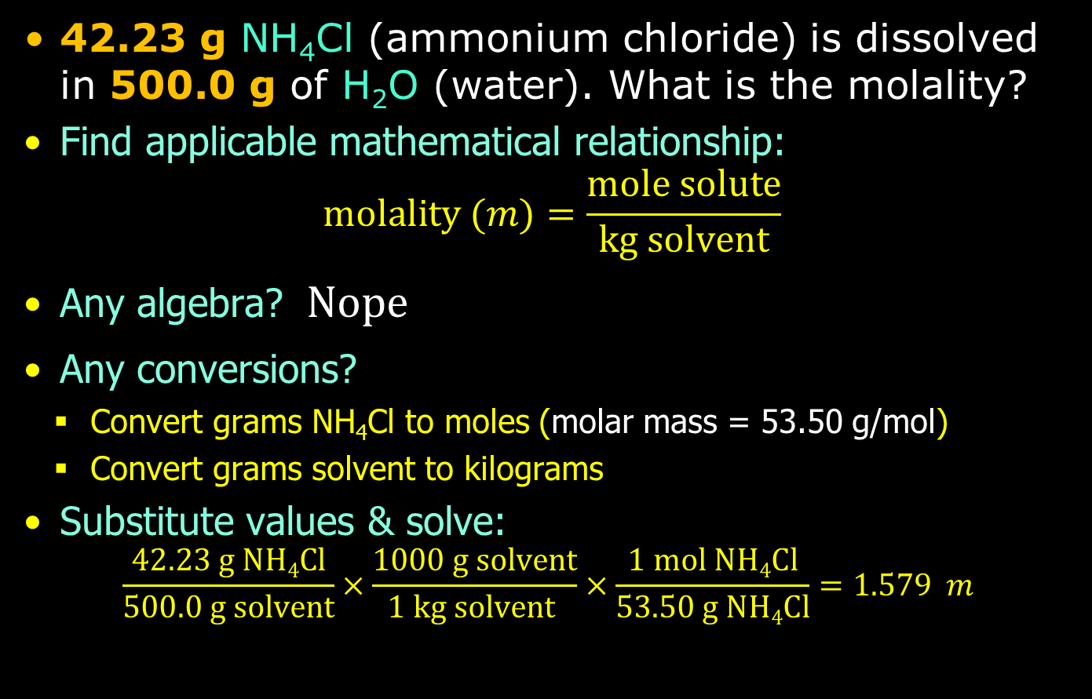
Practice: Molality
42.23 g NH₄Cl (ammonium chloride) is dissolved in 500.0 g of H₂O (water). What is the molality?
Find applicable mathematical relationship:
$molality (m)=\frac{mole solute}{kg solvent}$
Any algebra? $Nope$
Any conversions?
  Convert grams NH₄Cl to moles (molar mass = 53.50 g/mol)
  Convert grams solvent to kilograms
Substitute values & solve:
$$\frac{42.23 g NH4Cl}{500.0 g solvent}×\frac{1000 g solvent}{1 kg solvent }×\frac{1 mol NH4Cl}{53.50 g NH4Cl}=1.579 m$$

Slide 47
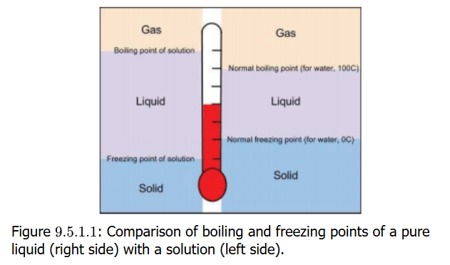
Boiling Point and Freezing Point
Two properties solutes in a solvent affect are
  increase (elevation) of the boiling point of the solvent
  decrease (depression) of the freezing point of solvent
Pure H₂O (water)
at P = 1 atm
  boils at 100°C
  freezes at 0°C
When table salt is added
  the boiling point goes
  above 100°C
  the freezing point falls below 0°C
It does not matter what the solute is though
0.20 m NaCl and 0.20 m HCl would cause the boiling point and freezing point changes in same way

Slide 48
Solute “Particle Number”
Colligative properties are about number of solute particles
When a molecule like glucose dissolves in water, glucose is a particle not different when dissolved than when a dry solid
But when an ionic compound like NaCl dissolves, it creates two particles as ions: Na⁺ and Cl–
When CaCl₂ dissolves, it creates three particles as ions: one Ca²⁺ and two Cl– ions
The molality of the solution and whether ionic or not ionic (i.e. molecular/covalent) is the indicator
Look for the number of ions produced when dissolved
Multiply molality (m) by number of particles (ions or molecular) to get total particle concentrations
Compare values of the solutions: higher total particle concentration will given higher b.p. and lower f.p. values

Slide 49
Effective Particle Molality
Rank these solutions from higher b.p./lower f.p. values.
0.1 m NaCl
0.1 m C₆H₁₂O₆
0.1 m CaI₂
NaCl → 2 particles (ions: Na⁺, Cl–)
  Effective particle molality = 2 x 0.1 m = 0.2 m
C₆H₁₂O₆ → 1 particle (the molecule)
  Effective particle molality = 1 x 0.1 m = 0.1 m
CaI₂ → 3 particles (ions: Ca²⁺, two I–)
  Effective particle molality = 3 x 0.1 m = 0.3 m

Slide 50
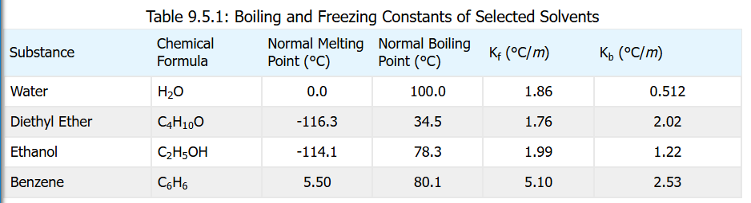
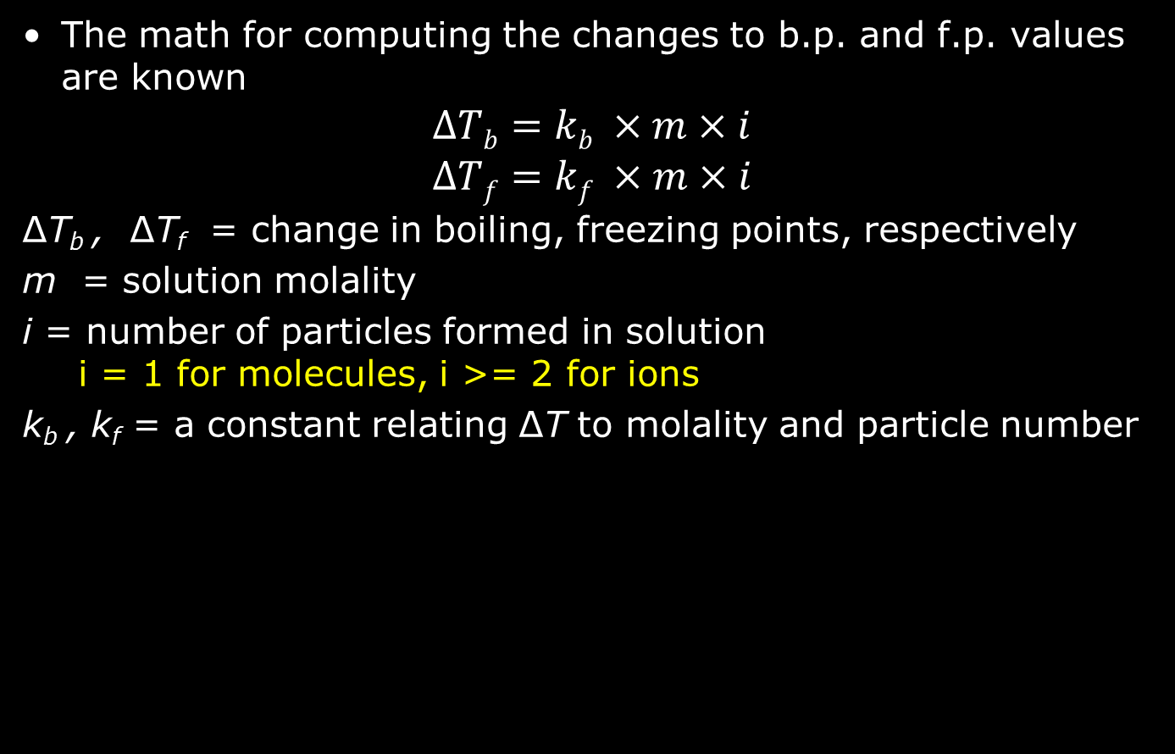
Computing B.P. / F.P. Changes
The math for computing the changes to b.p. and f.p. values are known
$$ΔTb=kb ×m×i$$
$$ΔTf=kf ×m×i$$
ΔT_{b} , ΔT_{f} = change in boiling, freezing points, respectively
m = solution molality
i = number of particles formed in solution
i = 1 for molecules, i >= 2 for ions
k_{b} , k_{f} = a constant relating ΔT to molality and particle number

Slide 51
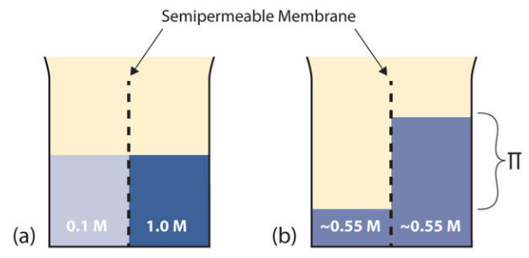

Osmosis
Osmosis is net movement of solvent molecules (typically water) across a selectively
(“semi-”) permeable membrane because solution concentrations differ across the membrane
Solute is not permeable (does
not pass through the
membrane) but solvent
molecules do pass
The movement of solvent
molecules is because a force
(as a pressure) to equalize
or the solute concentrations
on both sides
This can cause the volume of
solution to be greater on one
side of the membrane compared
to the other
Figure: Osmosis. (a) Two solutions of differing concentrations are placed on either side of a semipermeable membrane. (b) When osmosis occurs, solvent molecules selectively pass through the membrane from the dilute solution to the concentrated solution, diluting it until the two concentrations are the same. The pressure exerted by the different height of the solution on the right is called the osmotic pressure. (CC BY-SA-NC 3.0; anonymous)

Slide 52
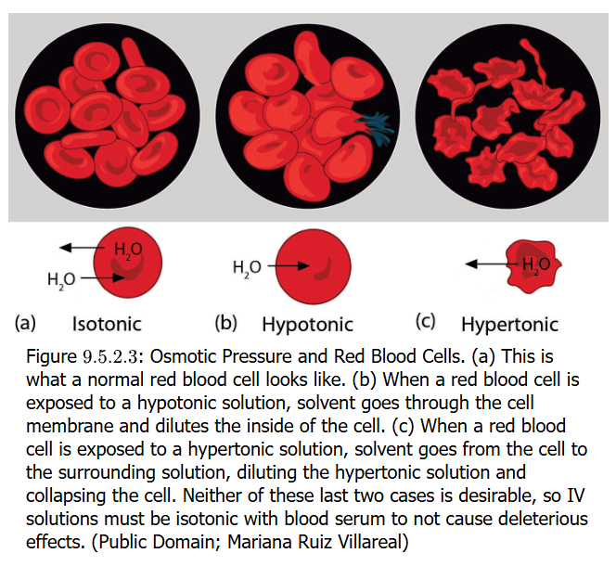
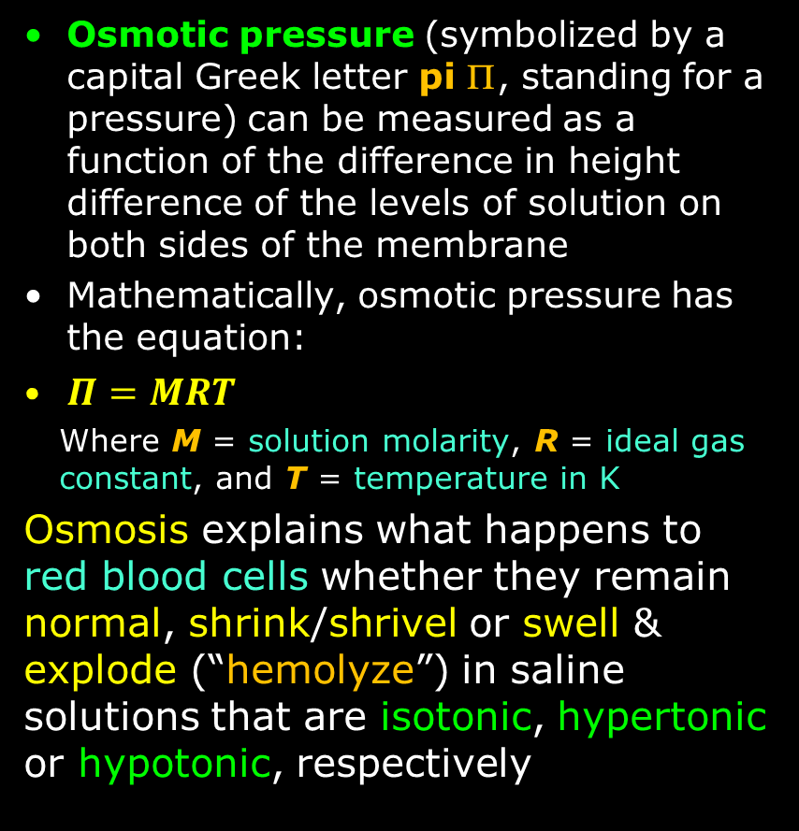
Osmotic Pressure
Osmotic pressure (symbolized by a capital Greek letter pi Π, standing for a pressure) can be measured as a function of the difference in height difference of the levels of solution on both sides of the membrane
Mathematically, osmotic pressure has the equation:
$Π=MRT$
  Where M = solution molarity, R = ideal gas constant, and T = temperature in K
Osmosis explains what happens to red blood cells whether they remain normal, shrink/shrivel or swell & explode (“hemolyze”) in saline solutions that are isotonic, hypertonic or hypotonic, respectively

Slide 53
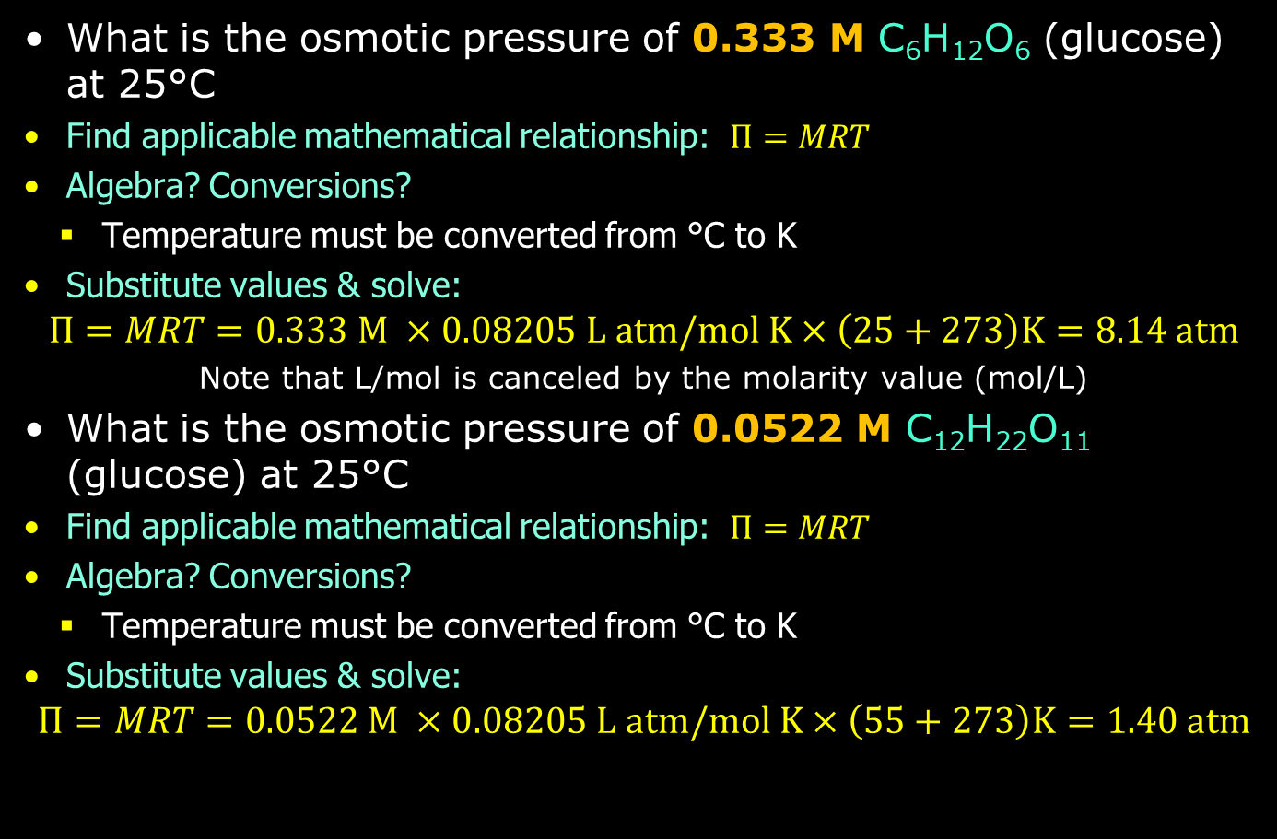
Practice: Osmotic Pressure
What is the osmotic pressure of 0.333 M C₆H₁₂O₆ (glucose) at 25°C
Find applicable mathematical relationship: $Π=MRT$
Algebra? Conversions?
  Temperature must be converted from °C to K
Substitute values & solve:
$$Π=MRT=0.333 M ×0.08205 L atm/mol K×\left(25+273\right)K=8.14 atm$$
Note that L/mol is canceled by the molarity value (mol/L)
What is the osmotic pressure of 0.0522 M C₁₂H₂₂O₁₁ (glucose) at 25°C
Find applicable mathematical relationship: $Π=MRT$
Algebra? Conversions?
  Temperature must be converted from °C to K
Substitute values & solve:
$$Π=MRT=0.0522 M ×0.08205 L atm/mol K×\left(55+273\right)K=1.40 atm$$

